Slide 1
Visual Accessibility in Styling
Increase accessibility
Sync accent colors (public page & data portal)
Updated Color Palette

Slide 2
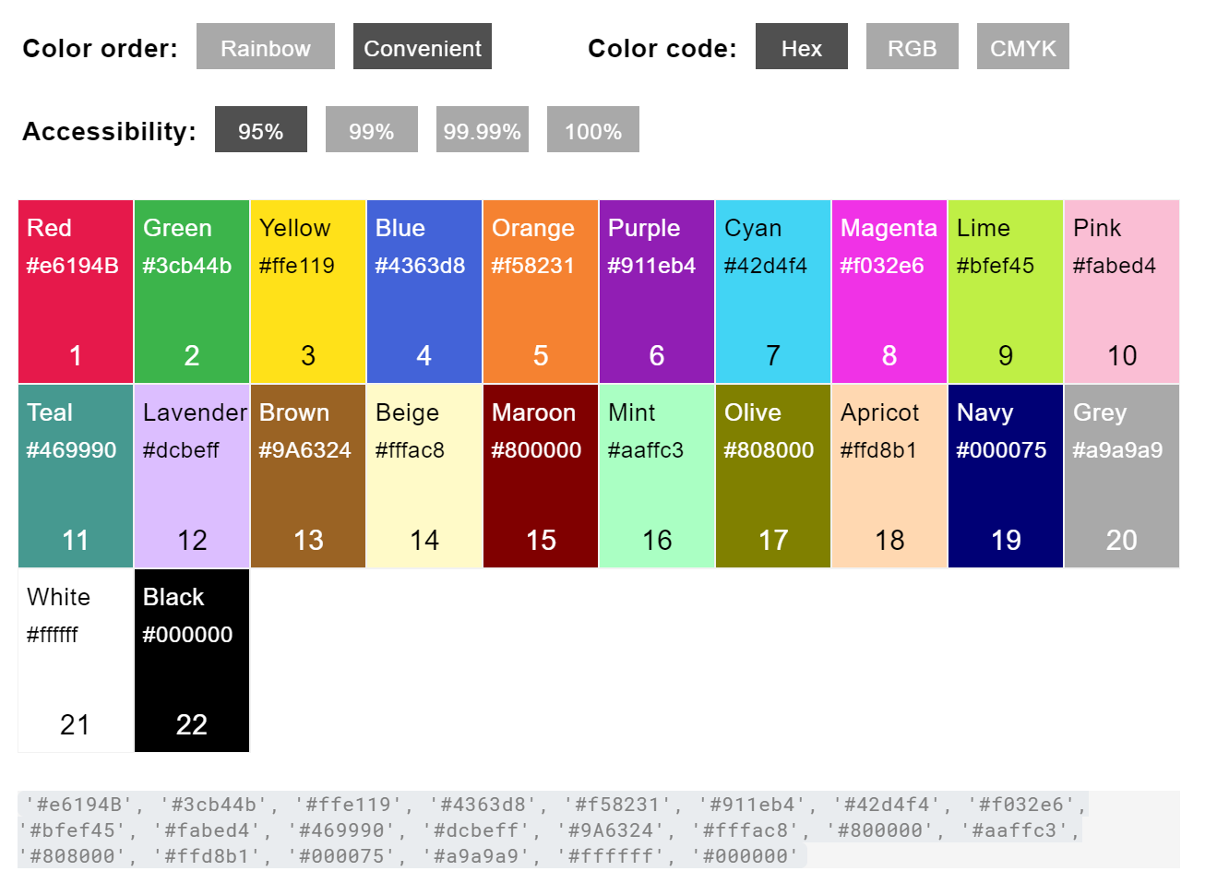
Context
Increase accessibility
"List of 20 Simple, Distinct Colors" provided by Tim

Slide 3
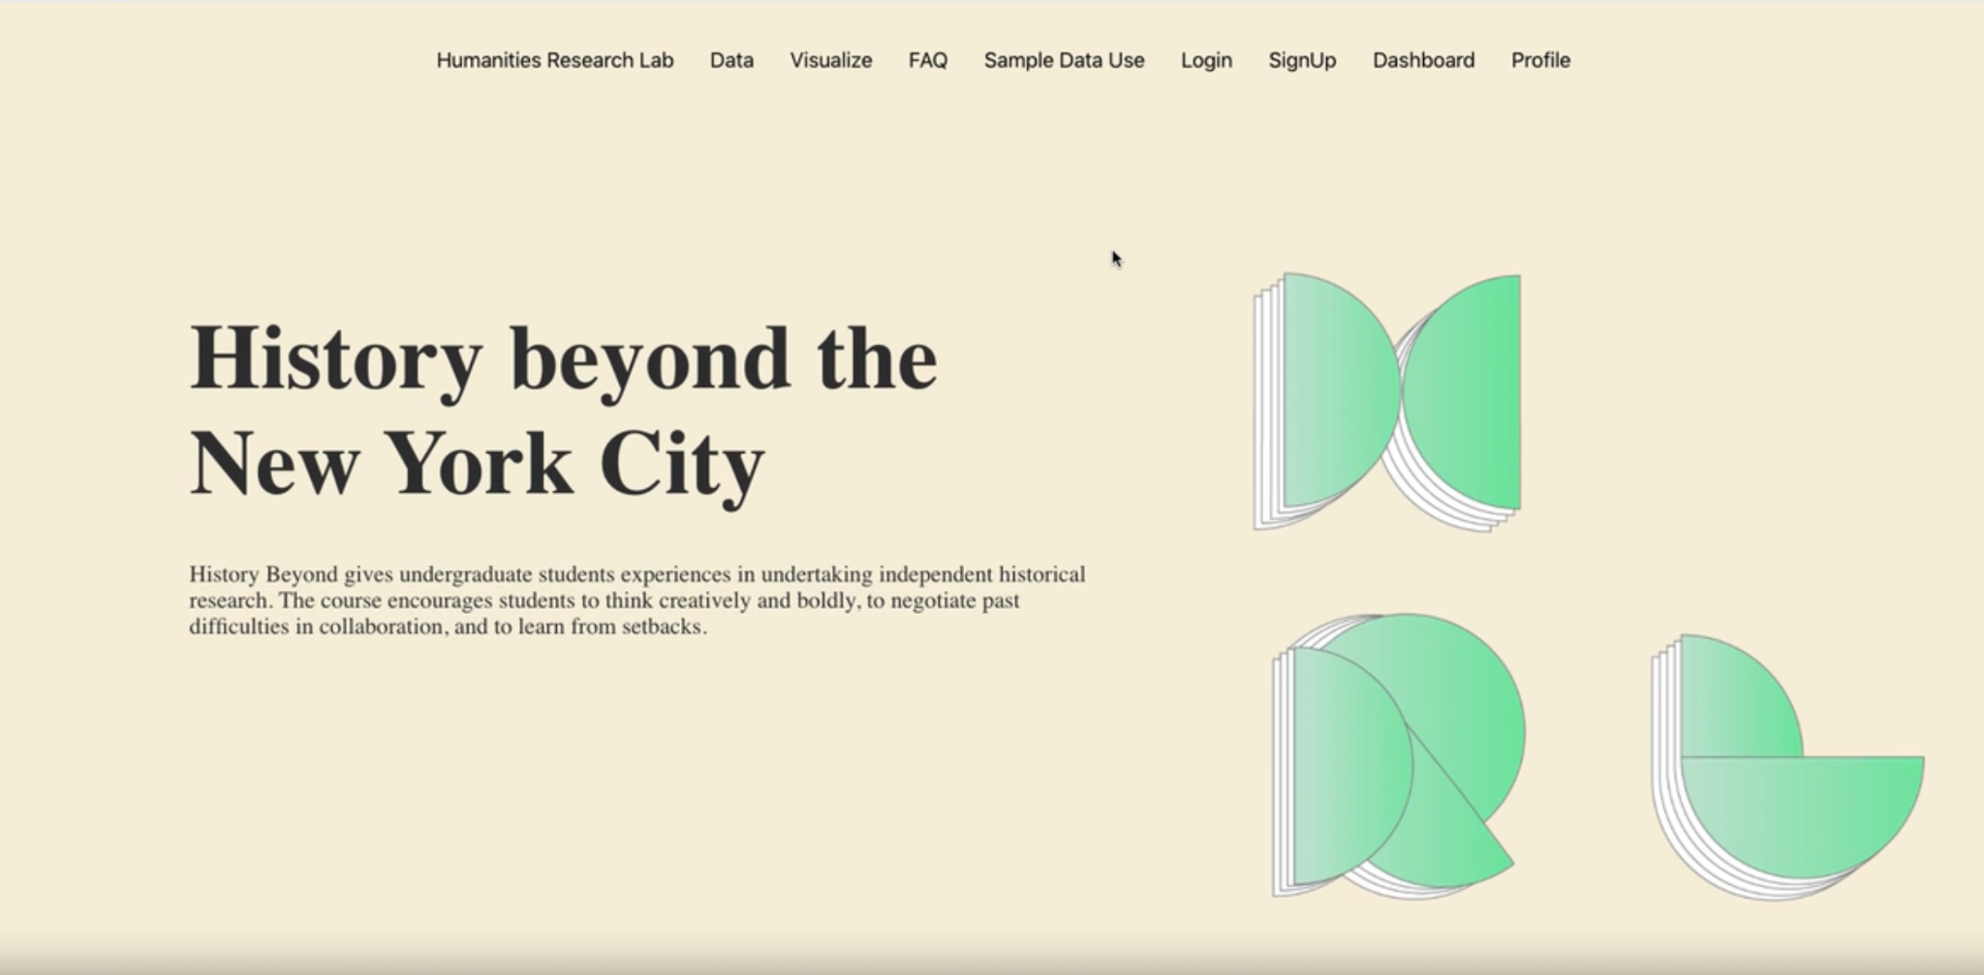
Checking our palette’s accessibility - Public
Increase accessibility (logo) - Pam
Web Content Accessibility Guidelines (WCAG) 2.0
Contrast ratio 3 = level AA: minimum recommended level of accessibility
Using Color Safe to double check our own palette according to WCAG guidelines
Text ✅
Logo ❌
Possible option for higher contrast:

Slide 4
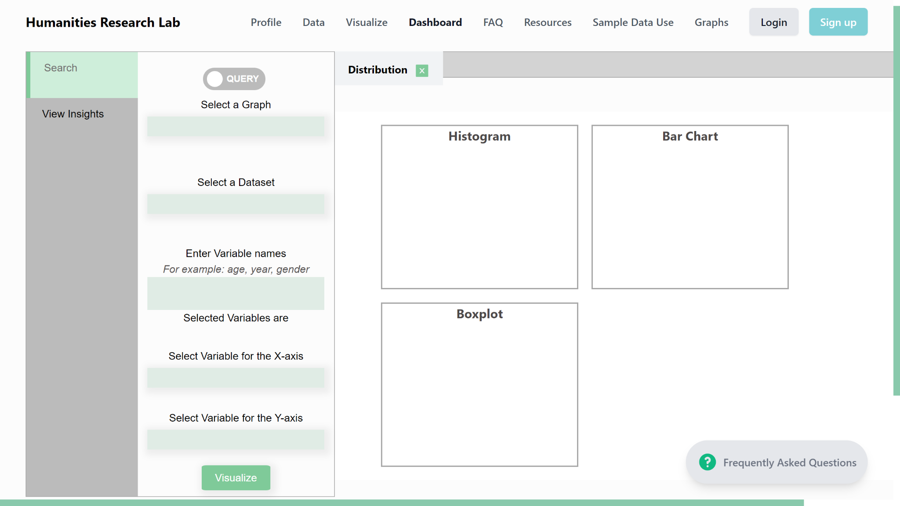
Checking our palette’s accessibility - After login
Increase accessibility (small edits) - Yufeng
Web Content Accessibility Guidelines (WCAG) 2.0
Contrast ratio 3 = level AA: minimum recommended level of accessibility
Using Color Safe to double check our own palette according to WCAG guidelines
Black/ dark grey text ✅
White/ light grey text ❌
Possible option for higher contrast

Slide 5
Sync Accent Colors (small edits) - Yufeng
“Sign up” button and “Visualize” button should be same as homepage
(see next page for updated palette)

Slide 6
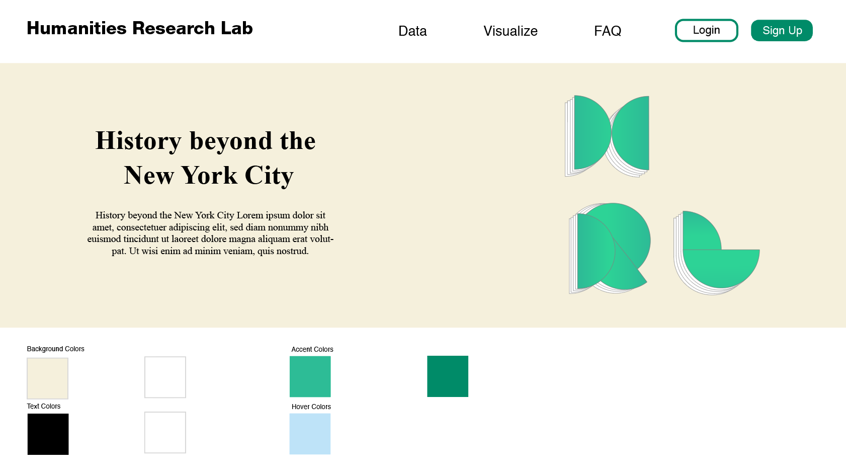
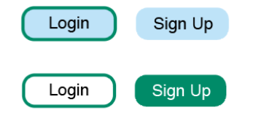
Updated Palette
#f5f0dc
Homepage Logo Background
#ffffff
General
Background
#2DBC96
Logo/ Scroll bar
#008B68
Button 1 border/ Button 2 background
#000000
Text against
light background
#ffffff
Text against
dark background
#BEE3F8
Hover background for buttons
Original
Hovered

Slide 7
Graph Palette
Graph palette TBD after everyone is done with charts, please be creative!
Follow the web accessibility notes
Provided by Sarah and Alma

